Slide 1


FORMAZIONE AGID – FORMEZ SULLA TRANSIZIONE DIGITALE DELLA PA
Progetto Informazione e formazione per la transizione digitale della PA nell'ambito del progetto «Italia Login – la casa del cittadino»
(A valere sul PON Governance e Capacità Istituzionale 2014-2020)

Slide 2

Verso le linee guida open data: panoramica chiara sul framework europeo e nazionale e casi applicativi locali
Panoramica su strategia e legislazione europee in materia di dati
4 maggio 2022
Daniele Rizzi
European Commission, DG CNECT, unit G1 - Data Policy and Innovation

Slide 3




European Strategy for Data
A common European data space, a single market for data
Data can flow within the EU and across sectors –
FFD Regulation
Availability of high quality data to create and innovate
European rules and values are fully respected
GDPR
Rules for access and use of data are fair, practical and clear & clear data governance mechanisms are in place
Benefitting from the second wave of industrial data

Slide 4




Deploying the strategy through 4 Pillars
A cross-sectoral governance framework for data access and use
including a legislative framework for the governance of European data spaces and other cross- sectoral measures for data access and use
Enablers
Investments in a High Impact Project on European data spaces and federated cloud infrastructures
Competences
Empowering individuals, investing in digital skills & data literacy and in dedicated capacity building for SMEs.
Rollout of common European data spaces
in crucial economic sectors and domains of public interest, looking at data governance and practical arrangements.
International Aspects

Slide 5
European Strategy for Data: 4 key instruments
Nov 2020
Public sector data, private sector data and personal data voluntarily made available by data holders
Data Governance Act
Ensure TRUST in data transactions
Dec 2020
Personal data and private sector data held by online platforms and originating from the users (both businesses and individuals)
Digital Market Act
Regulate MARKET POWER based on data
Q2 2022
Unleash the socio-economic potential of data as a raw material for innovation, in particular SMEs
Implementing Act under Open Data Directive
Public sector data of high value
Q1 2022
Ensure FAIRNESS in the allocation of data value among the actors of the data economy
Private sector data, personal data and co-generated (IoT) data
Data Act

Slide 6
Aim
How public sector bodies make data paid for by the public purse available
Who can access and use data in B2B, B2G and B2C relations and under which conditions + cloud switchability
Organisations that bring demand and supply of data together
How gatekeepers should use and make certain data available
ODD
DGA
DA
DMA
Opening up data
Correcting market imbalances
GDPR and FFoD ensure data protection and free flow of data across the board
DA Data Act
DMA Digital Markets Act
DGA Data Governance Act
ODD Open Data Directive
FFoD Free Flow of Data Regulation
GDPR General Data Protection Regulation
GDPR
FFoD
For the processing of personal data, GDPR always applies
Data localisation requirements in the Union, introduces basis of CoC for cloud service providers
Legend

Slide 7
Data Governance Act
The Data Governance Act will increase trust in data sharing and lower transaction costs by:
regulating neutral data intermediaries, essentially the orchestrators that bring those who have the data and those who want to use it of data together;
putting in place requirements for the secure re-use of protected publicly held data;
providing a framework for data altruism organisations in order to facilitate data sharing for the common good
setting up the European Data Innovation Board, in the form of an expert group for the data economy, that will foster the emergence of standards for cross-sector interoperability.
Proposal for a REGULATION OF THE EUROPEAN PARLIAMENT AND OF THE COUNCIL on European data governance (Data Governance Act) - COM/2020/767 final

Slide 8
Re-use of categories of protected public data
Complementary to Open Data Directive (last revised 2019):
Shall cover data that can only be used under certain conditions, because others have rights on that data (personal data, trade secrets, confidential business information, IP)
Building on national access regimes: where re-use happens, it should do so in a harmonised manner, subject to conditions
Leaves room for MS, but aims to create at least one contact point (single information point) for liaison between re-users and public sector bodies/competent bodies
EVIDENCE:
More than 75% of stakeholders considered that public authorities should make a broader range of sensitive data available for R&I purposes for the public interest.

Slide 9
European Data Innovation Board
Advising and assisting the Commission in developing a consistent practice for re-use, data intermediaries and data altruism entities;
Governance of technical standardisation to enhance interoperability;
Facilitating the cooperation of the work of national competent authorities for enhanced data use.
EVIDENCE:
91% of respondents consider that standardisation is necessary to improve interoperability and ultimately data re-use across sectors.
83,3% consider public authorities should play a role in standardisation (funding to open standards and for testing, prioritisation and coordination of standardisation).

Slide 10







Data Act: Scope of rights and obligations
Better access to IoT data
  Manufacturers of IoT objects need to allow access & can use the data
  Users of IoT objects get right to access and port data
  3rd parties can use the data to offer services (SMEs get special conditions)
  Rules for IoT data also frame data sharing in other sectors
Tackle contractual unfairness
Companies are prohibited from unilaterally imposing unfair contractual clauses related to data sharing on SMEs
Make business data available for the common good
Companies must make data available to public sector bodies in case of emergencies and other exceptional needs
Easier switching between cloud services
Cloud service providers must ensure easy switching conditions for customers
Facilitate data flows through technical standards and interoperability
The European Commission may adopt technical specifications if necessary to ensure interoperability

Slide 11

Proportionate, limited and predictable business-to-government rules
Data is requested based on an exceptional need:
to respond to a public emergency (free)
to prevent or to address the aftermath of a public emergency (cost + margin)
for other exceptional needs (cost + margin)
Public sector body must demonstrate the exceptional need
Private sector will benefit from streamlined procedures and from the “once-only principle”
Public sector body requests data based on an exceptional need
Data is destroyed after use
Public sector body
Private sector body makes data available
Private sector
Existing and future [compliance, reporting] sectoral obligations (incl. for law enforcement purposes) continue to apply
Public sector body
or
Union institution, agency or body
If request is valid, data must be made available

Slide 12
Open Data directive (2019/1024 of 20/6/2019)
Implementing Act : list of high value datasets
Geospatial
Earth observation and environment
Meteorological
Statistics
Companies and company ownership
Mobility
Datasets listed in the implementing act to be made available:
  for free
  in machine-readable formats
  via APIs and (where relevant) as bulk downloads
Impact Assessment positive opinion
Expected adoption: Q2/2022

Slide 13
Geospatial – preliminary draft Implementing Regulation
Datasets | Administrative units | Geographical Names | Addresses | Buildings | Cadastral parcels | Agricultural parcels and livestock
Granularity | All generalisation levels available up to the level of scale 1:5000. From municipalities to countries; sea-frontiers. | N/A | N/A | All generalisation levels available up to the level of scale 1:5000. | All generalisation levels available up to the level of scale 1:5000. | Equivalent to 1:5000 as referred to in Article 70(1) of the Regulation (EU) 1306/2013
Geographical coverage | National or partial (i.e. covering the entire country when combined). | National or partial (i.e. covering the entire country when combined). | National or partial (i.e. covering the entire country when combined). | National or partial (i.e. covering the entire country when combined). | National or partial (i.e. covering the entire country when combined). | National (if regional design is applied, the addition of regions should cover the entire country).
Key attributes | Unique identifier; Geometry; Latitude and longitude; Boundary; National identification code; identification code of the upper administrative level; official name; country code; name in multiple languages (only for countries with more than one official language). | Unique identifier; Geometry; Name; name in multiple languages (only for countries with more than one official language); category; latitude and longitude (as per INSPIRE specifications) | Unique identifier; Geometry; Latitude and longitude; address locator (e.g. house number); thoroughfare (street); name; administrative units (e.g. municipality; province, country; postal descriptor (e.g. post code); date of last update. | Unique identifier; Geometry/Footprint of the building; floors; type of use. | Unique identifier; Geometry (boundary) of cadastral parcels; type of parcel; parcel code; references to the administrative area to which the parcel belongs. | Reference parcels as defined by Commission Delegated Regulation (EU) 640/2014); Agricultural area (‘land cover’) as referred to in article 4(1)(e) of Regulation (EU) No 1307/2013; Agricultural parcels (‘land use’) as referred to in Article 67(4)(a) of Regulation (EU) 1306/2013 and Article 5(2) of Commission Delegated Regulation (EU) 640/2014; Geometry and land use of agricultural parcels as referred to in Article 14(d) of Commission Delegated Regulation (EU) 809/2014; crop groups associated as referred to in Article 17 of Commission Delegated Regulation (EU) 640/2014; Landscape features and trees as referred to in Article 9(1) of Commission delegated Regulation (EU) 640/2014; Type of animals and number of each type of animals (Article 21c of Commission Delegated Regulation (EU) 809/2014

Slide 14
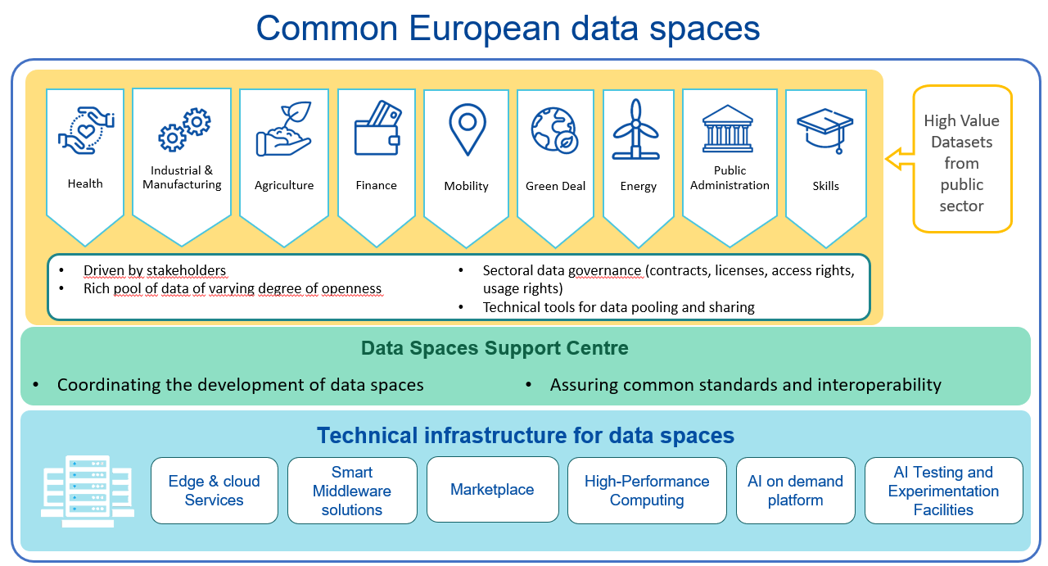
High Value Datasets and Data Spaces

Slide 15
Towards Data Spaces: Data sharing models
Current situation
Data space
One to one sector-specific data sharing based on contractual agreements.
Data sharing infrastructures
  with centralized data hosting,
  and/or data marketplaces to enable discovery and reduce transaction costs where data is not held in a central repository.
An ecosystem where links are created between data space participants.
Federated data is stored in a distributed manner with tools to enable discovery, access, and analysis across industries, companies, and public entities.

Slide 16
Key characteristics of a data space
A secure and privacy-preserving IT infrastructure to pool, access, process, use and share data.
A data governance mechanism, comprising a set of rules of legislative, administrative and contractual nature that determine the rights to access, process, use and share data in a trustful and transparent manner.
Data holders are in control of who can have access to their data, for which purpose and under which conditions it can be used.
Presence of vast amounts of data that are made available on a voluntary basis and can be reused against remuneration or for free, depending on the data holder’s decision.
Participation by an open number of organisations/individuals.

Slide 17









Digital Europe Programme: the structure
accelerating the best use of digital technologies
Digital Innovation
Hubs
High impact deployments
Building essential
digital capacities
High Performance Computing
Artificial Intelligence
Cybersecurity
Advanced Digital Skills

Slide 18
DIGITAL approach for the deployment of sectoral data spaces
I
Support the creation of initial data infrastructures
Establishing a stakeholders network
II
Federation of projects in large data spaces
III
Coordination Support Action
Grants
Grants
Roles: Participant (Data Provider | Data User);
Data intermediary.
Technology provider.

Slide 19
Data Spaces in DIGITAL
Green Deal
Smart communities
Agriculture
Mobility
Health - Genomics
Skills
Manufacturing
Public Procurements
Financial
Tourism
Language
Cultural Heritage
Media
Health Cancer Images
Security data space for innovation

Slide 20
Main synergies in the context of the capacity building for data and data ecosystem
 | CEF Digital – Work Programme 2021-2023 | Digital Europe – Work Programme 2021-2022 | Recovery & Resilience Facility (decided by Member States)
Making sense of Data |  | National HPC Competence Centres AI on demand platform Deployment Demonstrators for industrial/sectorial HPC tools, codes & software environment Testing and Experimentation Facilities for Manufacturing, Health, Agri-food, smart cities and communities EDIHs supporting SMEs and public sector for AI | Building up AI testing and experimentation capacities, and AI digital innovation hubs.
Supporting Data Ecosystems |  | Deployment of data spaces for the Green deal, Mobility, Manufacturing, Agriculture, Cultural Heritage, Health, Media, Public administration, Public Procurement, Law enforcement, Finance. Data spaces Support Centre Open data Platform and making accessible High Value Datasets held by public sector | Stimulate the deployment of data infrastructure for the creation of data spaces, including the adoption of common standards, interoperability and governance mechanisms.
80% of European data processing at the edge | Studies to interconnect cloud backbone networks 5G coverage along transport corridors 5G for smart communities | Cloud-to-edge-based services, built over the smart middleware platform Testing and Experimentation Facilities on Edge AI | Stimulate the emergence and deployment of federated European cloud to edge services and platforms, leveraging existing initiatives
A sovereign cloud stack | European DNS resolver
A European vendor-neutral multi-cloud management solution |  | Smart middleware platform, including a sovereign EU multi-cloud solution A federated marketplace for cloud-to-edge-based services, AI, etc. Federation of HPC resources Acquisition of Supercomputers
(Interconnected) data processing capacities across Europe | Cross-border interconnection of cloud and edge capacities Terabit connectivity for High Performance Computing |  | Next generation cloud to edge data centres.

Slide 21

Per ulteriori informazioni:
European Commission's policies on the reuse of public sector information
A European Strategy for data
Data Governance Act
Data Act
Digital Europe Programme
email: CNECT-G1@ec.europa.eu
Unit G1 of DG CONNECT

