Slide 1
L’accessibilità dei servizi digitali nel contesto normativo vigente e del regolamento Europeo Single Digital Gateway

Slide 2
Di cosa parliamo
REGOLAMENTO (UE) 2018/1724 PARLAMENTO EUROPEO E DEL CONSIGLIO - 2 ottobre 2018.
Cos'è il Single Digital Gateway?
Elementi del Single Digital Gateway
Date di attuazione
Informazioni - Italia
Procedure - Italia
Qualità dei contenuti

Slide 3
REGOLAMENTO (UE) 2018/1724DEL PARLAMENTO EUROPEO E DEL CONSIGLIO
del 2 ottobre 2018
Istituisce uno sportello digitale unico per l’accesso a informazioni, procedure e servizi di assistenza e di risoluzione dei problemi e che modifica il regolamento (UE) n. 1024/2012
https://eur-lex.europa.eu/legal-content/EN/TXT/HTML/?uri=CELEX:32018R1724&from=IT

Slide 4
Cosa è il Single Digital Gateway?
Un unico punto di accesso alle informazioni, alle procedure e ai servizi di assistenza online
SDG dà accesso a:
Cittadini che vogliono trasferirsi in un altro paese dell'UE
Imprese che intendono fare affari in un altro paese dell'UE
Informazioni
Procedure
Servizi di assistenza
Notes:
The single digital gateway will facilitate online access to the information, administrative procedures and assistance services for citizens that want to move and businesses that want to do business in another EU country.

Slide 5
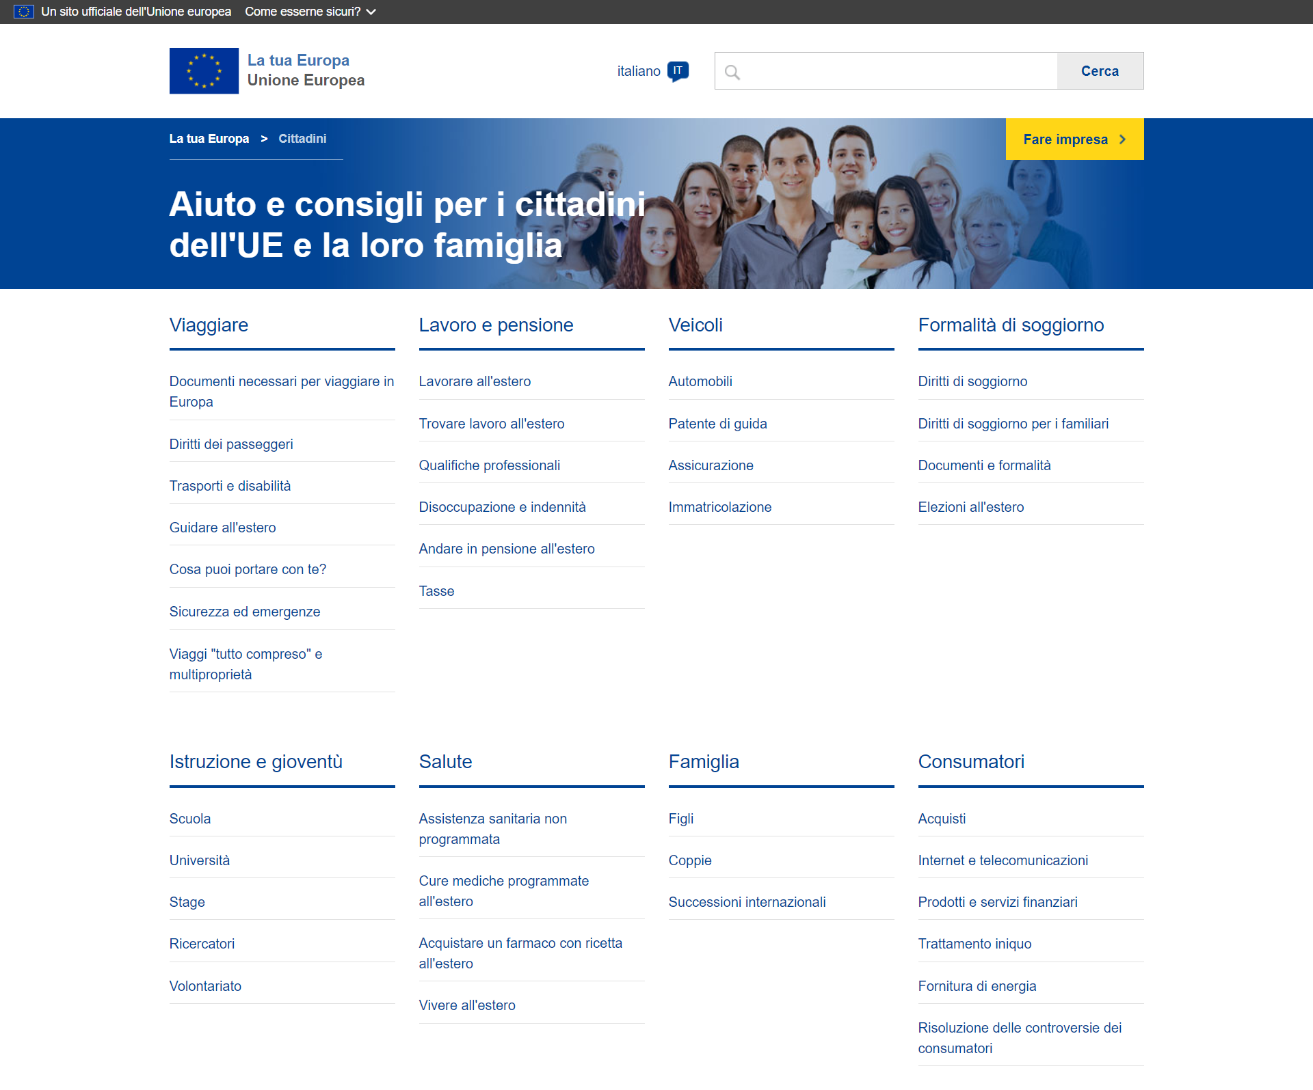
Si parte da Your Europe
https://europa.eu/youreurope/citizens/index_it.htm
"La tua Europa".
Interfaccia utente comune gestita dalla Commissione
Disponibile in tutte le lingue ufficiali delle istituzioni dell'Unione.
Notes:
The name by which the gateway is to be known and promoted to the general public shall be ‘Your Europe’
The gateway shall consist of a common user interface managed by the Commission (‘the common user interface’), which shall be integrated into the Your Europe portal and shall give access to relevant Union and national webpages
In order to facilitate the use of the gateway, the common user interface should be available in all official languages of the institutions of the Union (‘official languages of the Union’).

Slide 6
Attori coinvolti
PA Centrali
PA Locali
Notes:
There are four different actors involved in the process of complying with the Regulation 2018/1724:
European Commision: it leads, coordinates and monitor the implementation of the Regulation
Department for European Policies (Presidency of the Council of Ministers): it has been appointed as responsible for the implementation of the Regulation in Italy. It coordinates different italian public authorities
Agency for Digital Italy: it participates in the coordination table, by supporting the Department for European Policies in its operational activities
Central Authorities, Regional Authorities, Municipal authorities, Universities: they are responsible for conveying the information to the European citizens and businesses, and for putting online the procedures

Slide 7
PAC

Slide 8
Date di implementazione
Le informazioni devono essere pubblicate entro la fine del 2020
Notes:
Description of the different phases
By the end of 2020, citizens and companies moving across EU borders will easily be able to find out what rules and assistance services apply in their new residency.
By the end of 2023 at the latest, they will be able to perform a number of procedures in all EU member states without any physical paperwork, like registering a car or claiming pension benefits.

Slide 9
Informazioni

Slide 10
Requisiti di qualità relativi all’accessibilità della rete
(Art. 8)
Percepibili
Utilizzabili
Comprensibili
Solidi
Notes:
The Commission shall make those of its websites and webpages through which it grants access to the information and to the assistance and problem-solving services more accessible by making them perceivable, operable, understandable and robust.

Slide 11
Qualità delle informazioni sui diritti, sugli obblighi e sulle norme (Art. 9)
Facile da usare
Preciso e sufficientemente completo
Riferimenti, collegamenti ad atti giuridici, specifiche tecniche e linee guida
Nome dell'autorità competente
Contatto di eventuali servizi di assistenza o di risoluzione di problemi
Data dell'ultimo aggiornamento delle informazioni
Contenuto ben strutturato
Contenuto mantenuto costantemente aggiornato
Linguaggio chiaro e semplice
Traduzione in un’altra lingua ufficiale dell'Unione (inglese)
Notes:
Where Member States and the Commission are responsible in accordance with Article 4 for ensuring access to information referred to in point (a) of Article 2(2), they shall make sure that such information complies with the following requirements:
it is user-friendly, enabling users to easily find and understand the information and to easily identify which parts of the information are relevant to their particular situation;
it is accurate and sufficiently comprehensive to cover information that users need to know in order to exercise their rights in full compliance with applicable rules and obligations;
it includes references, links to legal acts, technical specifications and guidelines, where relevant;
it includes the name of the competent authority or entity responsible for the content of the information;
it includes the contact details of any relevant assistance or problem-solving services, such as a phone number, an email address, an online enquiry form or any other commonly used means of electronic communication that is most suitable for the type of service offered and for the target audience of that service;
it includes the date of the last update of the information, if any, or, where the information has not been updated, the date of publication of the information;
it is well-structured and presented, so that users can quickly find the information they need;
it is kept up-to-date; and
it is written in clear and plain language adapted to the needs of the target users.
It is accessible in an official language of the Union that is broadly understood by the largest possible number of cross-border users

Slide 12
Regolamento (CE) 2018/1724 - Articolo 9
Qualità delle informazioni sui diritti, sugli obblighi e sulle norme
Le informazioni di cui gli Stati Membri sono responsabili devono soddisfare una serie di requisiti:
Devono essere di facile utilizzo e consentire agli utenti il loro facile reperimento
Devono essere esatte e sufficientemente complete
Devono contenere - se necessario -riferimenti e link ad atti giuridici, specifiche tecniche e LG
Devono comprendere il nome dell’autorità competente o del soggetto responsabile del loro contenuto
Devono includere i recapiti di ogni pertinente servizio di assistenza (telefono, email, modulo richiesta online)
Devono includere la data dell’ultimo aggiornamento o - se non aggiornate - la data di pubblicazione
Devono essere ben strutturate per una loro rapida consultazione
Devono essere aggiornate
Devono essere scritte in linguaggio semplice e chiaro
Devono essere rese accessibili in una lingua ufficiale UE comprensibile dal maggior numero di utenti transfrontalieri

Slide 13
Usabilità - panoramica

Slide 14
Qualità informazioni sulle procedure
passi necessari
nome dell'autorità competente
mezzi di autenticazione, identificazione e firma accettati
tipo e formato della prova
i mezzi di ricorso o di ricorso generalmente disponibili in caso di controversie con le autorità competenti
le tasse applicabili e le modalità di pagamento online
le scadenze che l'utilizzatore o l'autorità competente devono rispettare
eventuali norme relative alla mancata risposta dell'autorità competente e alle conseguenze giuridiche che ne derivano per gli utenti
le eventuali lingue aggiuntive in cui la procedura può essere eseguita
Notes:
The Member States and the Commission shall, for the purposes of complying with Article 4, ensure that, before users have to identify themselves prior to launching the procedure, they have access to a sufficiently comprehensive, clear and user-friendly explanation of the following elements, where applicable, of the procedures:
the relevant steps of the procedure to be taken by the user, including any exception, under Article 6(3), to the obligation of Member States to offer the procedure fully online;
the name of the competent authority responsible for the procedure, including its contact details;
the accepted means of authentication, identification and signature for the procedure;
the type and format of evidence to be submitted;
the means of redress or appeal which are generally available in the event of disputes with the competent authorities;
the applicable fees and the online methods of payment;
any deadlines to be respected by the user or by the competent authority and where no deadlines exist, the average, estimated or indicative time that the competent authority needs to complete the procedure;
any rules concerning a lack of reply from the competent authority and the legal consequences thereof for the users, including tacit approval or administrative silence arrangements;
any additional languages in which the procedure can be carried out.

Slide 15
Alcuni riferimenti
OECD Recommendation on Digital Government Strategies - 2014
https://www.oecd.org/gov/digital-government/recommendation-on-digital-government-strategies.htm
European eGovernment Action Plan 2016-2020
https://ec.europa.eu/digital-single-market/en/european-egovernment-action-plan-2016-2020
Dichiarazione di Tallinn su eGovernemnt - 2017
https://ec.europa.eu/italy/news/20171006_dichiarazione_UE_su_egovernment_it
Notes:
The Commission shall make those of its websites and webpages through which it grants access to the information and to the assistance and problem-solving services more accessible by making them perceivable, operable, understandable and robust.

Slide 16
Thank you for your attention

